Slide 1
Unit-6
Neural Networks
Prepared By: Arjun Sing Saud
Asst. Prof. CSCSIT, TU

Slide 2
What is ANN?
Artificial Neural Network (ANN) is commonly referred as Neural Network (NN). It is the computational paradigm that is motivated from the way the computation is performed by human brain or nervous system.
Brain is a highly complex, non-linear, and parallel computation system that can perform computations like perception, pattern recognition, motor control etc. Neuron or nerve cell is the basic structural unit of brain.

Slide 3
What is ANN?
Human can perform the task much faster than the fastest digital computers that exists todays. This is possible due to parallel computation of neurons interconnected with each other.
Thus we can define ANN as “It is a massively parallel distributed processing system made up of simple processing units that has capability of storing knowledge and making it available for use.”
ANNs perform useful computations through the process of learning by using some algorithm.

Slide 4
Biological Neural Networks
Most living creatures, which have the ability to adapt to a changing environment, need a controlling unit which is able to learn.
Humans have very complex networks of highly specialized neurons to perform this task.
Human brain consists of a very large number of neurons, about 10¹¹ in average. These can be seen as the basic building bricks for the central nervous system.
The neurons are interconnected at points called synapses. The complexity of the brain is due to the massive number of highly interconnected simple units working in parallel, with an individual neuron receiving input from up to 10000 others.

Slide 5
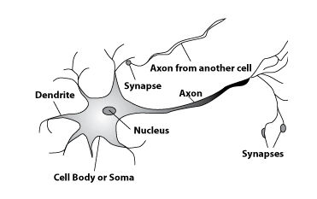
Biological Neural Networks

Slide 6
Biological Neural Networks
A human neuron contains:
a cell body for signal processing,
many dendrites to receive signals,
an axon for outputting the result, and
synapses between the axon and dendrites of other cells.

Slide 7
Biological Neural Networks
Signals come into the dendrites through the synapses of other neurons.
All signals from all dendrites are summed up in the cell body.
When the sum is larger than a threshold, the neuron fires, and sends out an output signal to other neurons through the axon.
The end of the axon is divided in many branches, called synapses, which are then connected to other dendrites of other cells.

Slide 8
Models of Neuron
A neuron is an information-processing unit that is fundamental to the operation of a neural network.
Basically, Models of neuron can be divided into two categories:
Deterministic model of Neuron
Stochastic model of Neuron

Slide 9
Models of Neuron
Deterministic Model of Neuron

Slide 10
Models of Neuron
Deterministic Model of Neuron
The block diagram this model of a neuron is presented in previous slide. Three basic elements of this neural model are: Synapses or connecting links, Adder, and Activation Function.
Synapses: These are the connecting links that are used to collect input for the neuron. Each link is characterized by weight that defines strength of the link.
Adder: It is responsible for finding weighted sum of inputs to the neuron.
Activation Function: It is responsible for finding output of the neuron. It is also referred as squashing function.

Slide 11
Models of Neuron
Deterministic Model of Neuron
The neural model also includes an externally applied bias, denoted by b_{k}. The bias b_{k} has the effect of increasing or lowering the net input. In mathematical terms, we may describe the neural model by writing the set of equations:
Where, x₁, x₂,….,x_{n} are input signals, w_{k1},w_{k2},….,w_{kn} are weights, u_{k} is weighted sum of inputs, φ is activation function, and y_{k} is output signal

Slide 12
Models of Neuron
Deterministic Model of Neuron
The use of bias b_{k} has the effect of applying an affine transformation to the output u_{k} of the linear combiner in the neural model.
Depending on whether the bias b_{k} is positive or negative, the relationship between the activation potential (v_{k}) and the linear combiner output (u_{k}) is modified as below.

Slide 13
Models of Neuron
Deterministic Model of Neuron
Activation Potential V_{k}

Slide 14
Models of Neuron
Example: Consider following neuron and compute its output by assume activation function F(x)=1 if x>5 and F(x)=0, otherwise
b=1
u=x₁*w₁+x₂*w₂+x₃*w₃
=2*1.5+1*2+2*0.5=6
v=u+b=6+1=7
Now,
y=f(v)=1
x₁=2
w₁=1.5
w₂=2
y
x₂=1
w₃=0.5
x₃=2

Slide 15
Models of Neuron
Deterministic Model of Neuron
We can reformulate the model of neuron by doing two things:
Adding a new input signal fixed at 1, and
Adding a new synaptic weight equal to the bias bk.
Although the two models are different in appearance, they are mathematically equivalent.

Slide 16
Models of Neuron
Deterministic Model of Neuron

Slide 17
Models of Neuron Contd…
Stochastic Model of Neuron
The deterministic neural model defines input–output behavior precisely for all inputs. However, stochastic model of neuron makes input-output behavior non-deterministic.
Stochastic neural model achieves this by giving probabilistic interpretation to the activation function used in deterministic neural model.
Specifically, a neuron is permitted to reside in only one of two states:+1 (ON) or -1 (OFF). The decision for a neuron to fire is probabilistic. Let x denote the state of the neuron and P(v) denote the probability of firing, where v is the activation potential of the neuron.

Slide 18
Models of Neuron Contd…
Stochastic Model of Neuron
This adds uncertainty to firing of neuron and hence makes the input-output behavior stochastic. Rest of things in stochastic model of neuron is similar to the deterministic model.

Slide 19
Models of Neuron Contd..
Example: Consider following stochastic neuron and compute its probability of firing by assuming T=5
u=x₁*w₁+x₂*w₂+x₃*w₃
=2*1.5+1*2+2*0.5=6
v=u+b=6+1=7
Now,
P(v)=1/(1+e^{-v/T})
=1/(1+e^{-7/5})=0.802
Thus, the probability of firing the neuron is 0.802
b=1
x₁=2
w₁=1.5
w₂=2
y
x₂=1
w₃=0.5
x₃=2

Slide 20
Activation Functions
Activation functions are the functions responsible to convert a input signal of a node in a ANN to an output signal.
The activation function is the non linear transformation that we do over the input signal. This transformed output is then sent to the next layer of neurons as input.
Some widely used activation functions are: Threshold, linear, sigmoid, tanh, etc.

Slide 21
Activation Functions
Threshold Function
It is also referred as Healviside function. The non-linear neural model that use threshold function as activation function is referred as the McCulloch–Pitts model.
φ(x)

Slide 22
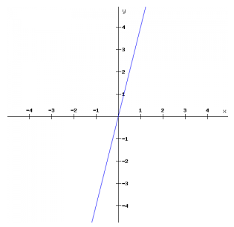
Activation Functions
Linear Function

Slide 23
Activation Functions
Sigmoid Function
By varying the parameter a (slope), we obtain sigmoid functions of different slopes. The sigmoid function is the class of functions whose graph is S-shaped curve. It is the most common form of activation function used in the construction of neural networks. An example of the sigmoid function is the logistic function, where a=1. It squashes the output in the range(0,1).
φ(x)

Slide 24
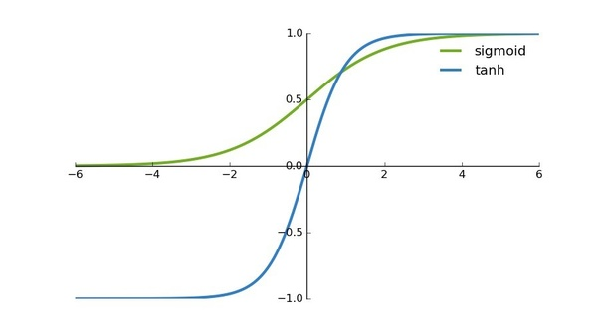
Activation Functions
Tanh Function
It has characteristics similar to sigmoid that we discussed above. But, it squashes the output between (-1,1). Tanh is also a very popular and widely used activation function. It is special case of sigmoid function.
φ(x)

Slide 25
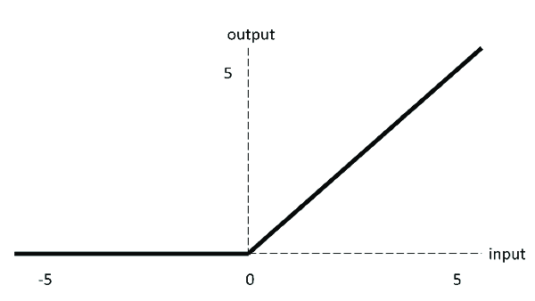
Activation Functions
ReLU Activation Function
ReLU is less computationally expensive than tanh and sigmoid because it involves simpler mathematical operations. This function is also non-linear.

Slide 26
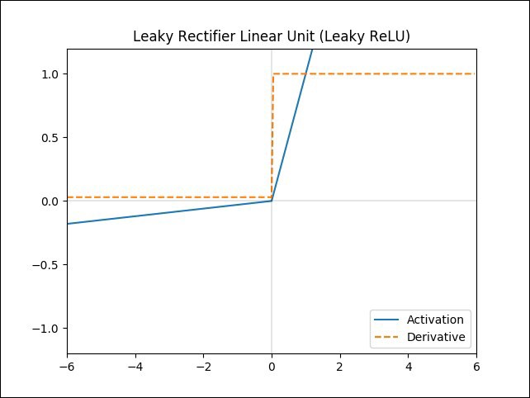
Activation Functions
Leaky ReLU Activation Function
Leaky ReLU, is a type of activation function based on a ReLU, but it has a small slope for negative values instead of a flat slope.

Slide 27
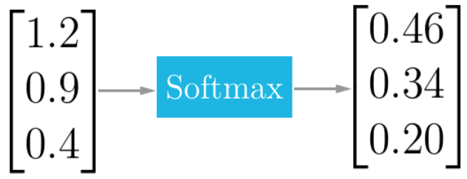
Activation Functions
Softmax Activation Function
Softmax is fundamentally a vector function. It takes a vector as input and produces a vector as output.
The Softmax function also squashes the outputs of each unit to be between 0 and 1. But it also divides each output such that the total sum of the outputs is equal to 1. The output of the Softmax function tells you the probability that any of the classes are true.

Slide 28
Structures of Neural Network
The manner in which neurons of a neural network are structured is called neural network architecture. Broadly, we can divide neural network architectures or structures into three categories.
Single-Layer Feedforward Networks
Multi-Layer Feedforward Networks
Recurrent Networks

Slide 29
Structures of Neural Network
Single-Layer Feedforward Networks
It is the simplest form of a network architecture. In this architecture we have an input layer of source nodes that are connected directly with an output layer of neurons (computation nodes), but not vice versa.

Slide 30
Neural Network Architectures
Multi-Layer Feedforward Networks
In this type of network architecture, one or more hidden layers are present between input and output layers. These layers are not directly visible and information only flows in the direction of input to output layer. This type of network is designed to extract higher order statistics from input.

Slide 31
Neural Network Architectures
Recurrent Networks
This class of networks are also referred ad feedback neural networks. This type of network architecture may contain feedback loop that can feed output of neuron as input to neurons of previous layers.

Slide 32
Neural Network Architectures
Example: Consider following Neural Network and compute its output using activation function F(x)=2x-1. Weights of synaptic links are provided above each link.
For Node 1
u1=2*0.8+3*1=4.6 => y1=f(u1)=2*4.6-1=8.2
For Node 2
u2=2*0.4+3*0.6=2.6 => y2=f(u2)=4.2
0.8
1.2
X1=2
1
3
1.5
0.4
0.4
5
1
0.7
X2=3
2
4
0.5
0.6
0.5

Slide 33
Neural Network Architectures
For Node 3
u3=8.2*1.2+4.2*0.4=11.51 =>y3=f(u3)=22.04
For Node 4
u4=8.2*0.7+4.2*0.5=7.84 =>y4=f(u4)=14.68
For Node 5
u5=22.04*1.5+14.68*0.5=40.4 => y5=f(u5)=79.8
Thus,
Final output of the neural network (y)=79.8

Slide 34
Learning in ANN
One of the most impressive features of artificial neural networks is their ability to learn. Artificial neural networks learns by adjusting the weighted connections found between neurons in the network.
Hence, a method is required with the help of which the weights can be modified. Following are some learning rules for the neural network:
Hebbian Learning Rule
Perceptron Learning Rule
Backpropagation Learning etc.

Slide 35
Learning in ANN
Hebbian Learning Rule
Hebbian Learning Rule was proposed by Donald Hebb in 1949.
The rule is based on the assumption that if two neighbor neurons activated and deactivated at the same time. Then the weight connecting these neurons should increase.
For neurons operating in the opposite phase, the weight between them should decrease. If there is no signal correlation, the weight should not change.

Slide 36
Learning in ANN
Hebbian Learning Rule
This assumption can be described by using following formula.

Slide 37
Learning in ANN
Hebbian Learning Algorithm
Initialize all weights and bias to zero
For each training vector s and target t perform steps 3 to 6
Set
Set y=t
Adapt weights as:
Adapt bias as:
Test for stopping criteria

Slide 38
Learning in ANN
Hebbian Learning
Example
Train the following NN by using given training set
x₁
w₁
x₁ | x₂ | t
1 | 1 | 1
1 | 0 | 0
0 | 1 | 0
0 | 0 | 0
w₂
y
x₂
b

Slide 39
Learning in ANN
Solution: =1
Thus, Final Neuron is
Input | w₁ (old) | w₂(old) | b(old) | w₁ (new) | w₂(new) | b(new)
(1,1,1) | 0 | 0 | 0 | 0+1*1*1=1 | 0+1*1*1=1 | 0+1*1=1
(1,0,0) | 1 | 1 | 1 | 1+1*1*0=1 | 1+1*0*0=1 | 1+1*0=1
(0,1,0) | 1 | 1 | 1 | 1+1*0*0=1 | 1+1*1*0=1 | 1+1*0=1
(0,0,0) | 1 | 1 | 1 | 1+1*0*0=1 | 1+1*0*0=1 | 1+1*0=1
x₁
w₁=1
w₂=1
y
x₂
b=1

Slide 40
Perceptron
The perceptron is the simplest form of a neural network used for the classifying linearly separable patterns. Patterns that can be separated by a hyperplane are called linearly separable patterns.
Basically, perceptron consists of a single neuron with adjustable synaptic weights and bias. The algorithm used to adjust the free parameters of this neural network is developed by Rosenblatt.

Slide 41
Perceptron
Rosenblatt proved that if the patterns (vectors) used to train the perceptron are drawn from two linearly separable classes, then the perceptron algorithm converges and positions the decision surface in the form of a hyperplane between the two classes.
The perceptron built around a single neuron is limited to performing pattern classification with only two classes. By expanding the output layer of the perceptron to include more than one neuron, we may correspondingly perform classification with more than two classes. However, the classes have to be linearly separable for the perceptron to work properly.

Slide 42
Perceptron
Rosenblatt’s perceptron is built around the McCulloch–Pitts model of a neuron.
The summing node of the neural model computes a linear combination of the input. The resulting sum is applied to a hard limit activation function.
The neuron produces an output equal to 1 if the hard limiter input is positive, and -1 if it is negative.

Slide 43
Perceptron
The hard limiter input (or induced local field) of the neuron is.

Slide 44
Perceptron
The goal of the perceptron is to correctly classify the set of externally applied stimuli x₁, x₂, ..., x_{m} into one of two classes,c1 or c2.The decision rule for the classification is to assign the point represented by the inputs x₁, x₂, ..., x_{m} to class c₁ if the perceptron output y is +1 and to class c₂ if it is -1.
In the simplest form of the perceptron, there are two decision regions separated by a hyperplane.

Slide 45
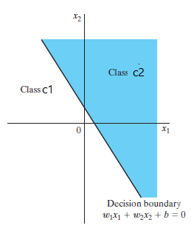
Perceptron

Slide 46
Perceptron
Perceptron can be trained to show behavior of AND function and OR function because both are linearly separable. But, perceptron can not be trained to learn behavior of XOR function because it is not linearly separable.
x₂
x₂
x₂
1
1
1
0
0
1
x₁
x₁
x₁
0
0
0
1
0
1
Fig: AND Function
Fig: XOR Function
Fig: OR Function

Slide 47
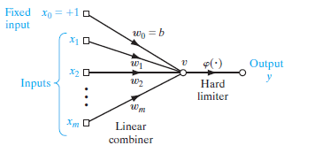
Perceptron Learning Rule
We can derive error correction rule for perceptron. Model of perceptron is given below,
For this model, we can write
Let x=[x_{0,} x_{1,} x_{2,……….} x_{m}] and w=[w_{0,} w_{1,……….} w_{m}]

Slide 48
Perceptron Learning Rule
Now, above equation can be written as:
Let us consider for n^{th} step input vector and weight vector is:
x=[x₀(n),x₁(n),…x_{m}(n)] and w=[w₀(n),w₁(n),…w_{m}(n)]
Now, for n^{th} step, above equation becomes
Suppose and C₁ and C₂ are two classes for which perceptron needs to be trained. So, training set must include sufficient examples from both classes.

Slide 49
Perceptron Learning Rule
Let H₁ and H₂ are set of training examples such that H₁∈C₁ and H₂∈C₂. Thus, Training Set(H)= H₁ ∪ H₂.
We know that perceptron puts data point in class C₁ if output is positive and in class C₂ if output is negative.
This means, data point lies in class C₁ if v>0 and in class C₂ if v≤0. Thus,
For each x∈ H_{1,} and
For each x∈ H_{2,}

Slide 50
Perceptron Learning Rule
Now, we can write weight update rule for n^{th} step as below.

Slide 51
Perceptron Learning Rule
The main theme of above weight change rule is:
Do not change weights in case of correct classification
Increase weights when perceptron output is smaller than actual target
Decrease weights when perceptron output is larger than actual target
Thus, we can represent weight change rule using single equation as below:

Slide 52
Perceptron Learning Rule
Perceptron Learning Algorithm
Initialize all weights and bias to zero
For each training vector s and target t perform steps 3 to 6
Set
Compute output using Hard limiter activation function as below
Adapt weights as:
Adapt bias as:
Test for Stopping Criteria

Slide 53
Perceptron Learning Rule
Perceptron Training
Example
Train the following perceptron by using given training set
x₁
w₁
x₁ | x₂ | t
1 | 1 | 1
1 | -1 | -1
-1 | 1 | -1
-1 | -1 | -1
w₂
y
x₂
b

Slide 54
Perceptron Learning Rule
Solution: =1
Epoch #1
Input | w₁ (old) | w₂ (old) | b (old) | v | y | w₁ (new) | w₂(new) | b(new)
(1,1,1) | 0 | 0 | 0 | 0 | 0 | 0+1*1*1=1 | 0+1*1*1=1 | 0+1*1=1
(1,-1,-1) | 1 | 1 | 1 | 1 | 1 | 1+1*-2*1=-1 | 1+1*-2*-1=3 | 1+1*-2=-1
(-1,1,-1) | -1 | 3 | -1 | 3 | 1 | -1+1*-2*-1=1 | 3+1*-2*1=1 | -1+1*-2=-3
(-1,-1,-1) | 1 | 1 | -3 | -5 | -1 | 1+1*0*-1=1 | 1+1*0*-1=1 | -3+1*0=-3

Slide 55
Perceptron Learning Rule
Epoch #2
Thus, Final Neuron is
Input | w₁ (old) | w₂ (old) | b (old) | v | y | w₁ (new) | w₂(new) | b(new)
(1,1,1) | 1 | 1 | -3 | -1 | -1 | 1+1*2*1=3 | 1+1*2*1=3 | -3+1*2=-1
(1,-1,-1) | 3 | 3 | -1 | -1 | -1 | 3+1*0*1=3 | 3+1*0*-1=3 | -1+1*0=-1
(-1,1,-1) | 3 | 3 | -1 | -1 | -1 | 2+1*0*-1=3 | 3+1*0*1=3 | -1+1*0=-1
(-1,-1,-1) | 3 | 3 | -1 | -7 | -1 | 3+1*0*-1=3 | 3+1*0*-1=3 | -1+1*0=-1
x₁
w₁=3
w₂=3
y
x₂
b=-1

Slide 56
Perceptron Learning Rule
Example 2
Train perceptron using given training set and predict class for the input (6,82) and (5.3,52)
Height(x₁) | Weight(x₂) | Class(t)
5.9 | 75 | Male
5.8 | 86 | Male
5.2 | 50 | Female
5.4 | 55 | Female
6.1 | 85 | Male
5.5 | 62 | Female

Slide 57
Perceptron Learning Rule
Solution
Normalize the input and encode target
Use min-max scaling y=(x-min)/(max-min)
Scaling of 5.9 :- (5.9-5.2)/(6.1-5.2)=0.7/0.9=0.778
Similarly normalize other values
Height(x₁) | Weight(x₂) | Class(t)
5.9 | 75 | Male
5.8 | 86 | Male
5.2 | 50 | Female
5.4 | 55 | Female
6.1 | 85 | Male
5.5 | 62 | Female
Height(x₁) | Weight(x₂) | Class(t)
0.778 | 0.694 | 1
0.667 | 1.000 | 1
0.000 | 0.000 | -1
0.222 | 0.139 | -1
1.000 | 0.972 | 1
0.333 | 0.333 | -1

Slide 58
Perceptron Learning Rule
Solution: =1
Epoch #1
Input | w₁ (old) | w₂ (old) | b (old) | v | y | w₁ (new) | w₂(new) | b(new)
0.78,0.69,1 | 0 | 0 | 0 | 0 | 0 | 0+1*1*0.78=0.78 | 0+1*1*0.69=0.69 | 0+1*1=1
0.67,1,1 | 0.78 | 0.69 | 1 | 2.21 | 1 | 0.78 | 0.69 | 1
0,0,-1 | 0.78 | 0.69 | 1 | 1 | 1 | 0.78+1*-2*0=0.78 | 0.69+1*-2*0=0.69 | 1+1*-2=-1
0.22,0.14,-1 | 0.78 | 0.69 | -1 | -0.73 | -1 | 0.78 | 0.69 | -1
1,0.97,1 | 0.78 | 0.69 | -1 | 0.45 | 1 | 0.78 | 0.69 | -1
0.33,0.33,1- | 0.78 | 0.69 | -1 | -0.51 | -1 | 0.78 | 0.69 | -1

Slide 59
Perceptron Learning Rule
Solution Contd..
Thus, Final perceptron is as below:
For (6,82)
Normalized value of 6=(6-5.2)/(6.1-5.2)=0.8/0.9=0.89
Normalized value of 82=(82-50)/(86-50)=32/36=0.89
x₁
w₁=0.78
w₂=0.69
y
x₂
b=-1

Slide 60
Perceptron Learning Rule
Solution Contd..
v=w₁x₁+w₂x₂+b=0.78*0.89+0.69*0.89-1=0.31
Thus, y=1
Hence, Predicted class for (6,82) is Male.
Similarly, we can predict class for (5.3,52)

Slide 61
XOR Problem
We know that single layer perceptron can be trained to classify patterns that is linearly separable.
However, XOR function is non-linearly separable as shown in the figure given below. Thus, we can not train single layer perceptron for XOR function. This, problem is called XOR Problem.
1
0
x₁
0
1

Slide 62
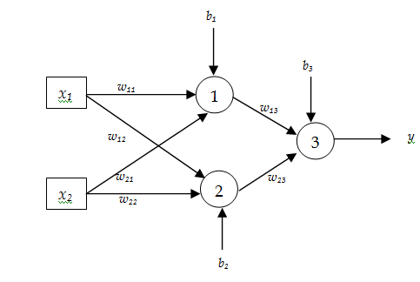
XOR Problem
We need to use multilayer perceptron that contains one hidden layer with two neurons to achieve XOR functionality from it.
Determine the weights of links for above MLP such that MLP functions as XOR. Assume that threshold activation function (as shown above) is used in each of the neuron.

Slide 63
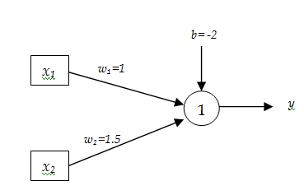
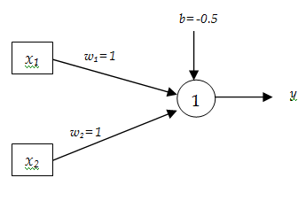
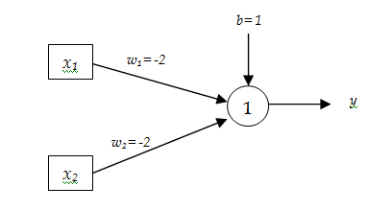
XOR Problem
We can have following realization of AND, OR, and NOR gates using perceptron.
Fig: AND Function
Fig: OR Function
Fig: NOR Function

Slide 64
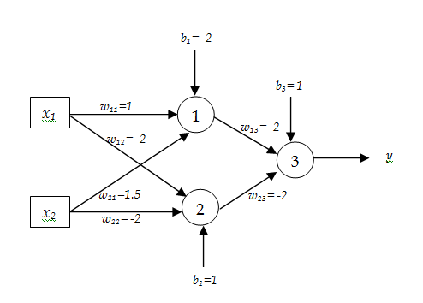
XOR Problem
XOR function can be represented in terms of function of AND and NOR functions as below.
NOR(AND(x₁,x₂),NOR(x₁,x₂))
Thus, Weights of MLP that acts as XOR function can be set as below

Slide 65
XOR Problem
CW
Realize NOT and NAND function using perceptron.
Can we realize XNOR function using perceptron? If yes, realize it using perceptron. Otherwise, realize XNOR function using MLP.

Slide 66
Backpropagation Algorithm
A popular method for the training of multilayer perceptrons is the back-propagation algorithm. The training proceeds in two phases:
Forward Phase: In this phase, the synaptic weights of the network are fixed and the input signal is propagated through the network, layer by layer, until it reaches the output. Thus, in this phase, changes are confined to the activation potentials and outputs of the neurons in the network.

Slide 67
Backpropagation Algorithm
Backward Phase: In this phase, an error signal is produced by comparing the output of the network with a desired response. The resulting error signal is propagated in backward direction through the network, again layer by layer. In this second phase, successive adjustments are made to the synaptic weights of the network

Slide 68
Backpropagation Algorithm
The error signal at the output of neuron j at iteration n is given by
The total error energy E(n) for all the neurons in the output layer is therefore

Slide 69
Backpropagation Algorithm
Let N be the total number of training vectors (examples). Then the average squared error is:
Consider the neuron j as given in next slide. The local field v_{j}(n) and output y_{j}(n) of neuron j is given by:

Slide 70
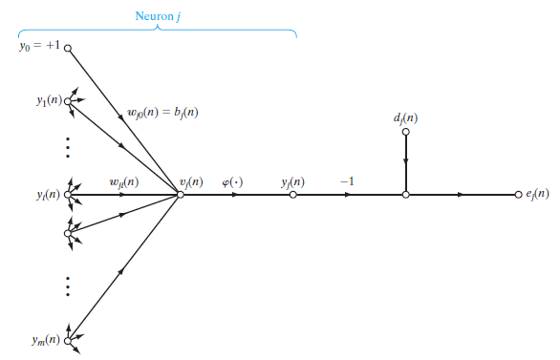
Backpropagation Algorithm

Slide 71
Backpropagation Algorithm
The correction made to the weight is proportional to the partial derivative of instantaneous error
Using the chain rule of calculus, this gradient can be expressed as follows:
We can get following partial derivatives

Slide 72
Backpropagation Algorithm
Putting all partial derivatives in equation 1, we get
The correction applied to the weight is defined by

Slide 73
Backpropagation Algorithm
Using equation (2), equation (3) can be written as
This can be written as
The error term in equation 4 and 5 depends upon location of neuron in the MLP. There can be two possible scenarios.

Slide 74
Backpropagation Algorithm
Case I: Neuron j is output layer neuron
The desired response d_{j}(n) for the neuron j is directly available. Computation of the error e_{j}(n) is straightforward in this case. We can use equation 4 or 5 to calculate weight update term.
Case II: Neuron j is hidden layer neuron
There is no desired response available for neuron j. The error signal for a hidden neuron must be determined recursively in terms of the error signals of all neurons connected to it as below:

Slide 75
Backpropagation Algorithm
Algorithm
Initialize all weights and biases in network
While terminating condition is not satisfied
for each training tuple X in D
for each input layer unit j: y_{j} = x_{j}; // output of an input unit is its actual input value
for each hidden or output layer unit j
compute the net input of unit j with respect to the previous
layer,
compute the output of each unit j

Slide 76
Learning in ANN
Algorithm
for each unit j in the output layer
for each unit j in the hidden layers, from the last to the first hidden layer
for each weight w_{ji} in network
//Weight Update

Slide 77
Backpropagation Algorithm
Case II: Hyperbolic Tangent Function
If we consider general Tanh function, then
Note: Compute Derivatives of Hyperbolic Function.

Slide 78
Backpropagation Algorithm
Backpropagation algorithm needs to compute
to compute . This depends upon choice of activation function.
Case I: Logistic Activation Function
If we consider general sigmoid function, then
Note: Compute Derivatives of Logistic activation function.

Slide 79
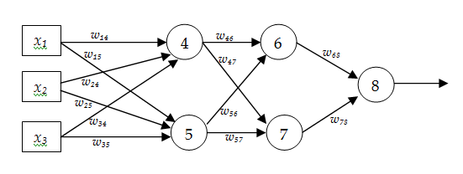
Backpropagation Algorithm
Example
Consider a MLP given below. Let the learning rate be 1. The initial weights of the network are given in the table below. Assume that first training tuple is (1, 0, 1) and its target output is 1. Calculate weight updates by using back-propagation algorithm. Assume .
w₁₄ | w₁₅ | w₂₄ | w₂₅ | w₃₄ | w₃₅ | w₄₆ | w₄₇ | w₅₆ | w₅₇ | w₆₈ | w₇₈
0.6 | 0.4 | 0.2 | -0.3 | 0.7 | -0.6 | 0.4 | 0.7 | 0.1 | 0.8 | 0.2 | 0.5

Slide 80
Backpropagation Algorithm
Solution
Forward Pass
v₄=1*0.6+0*0.2+1*0.7=1.3 y₄=1/1+e^{-1.3}=0.786
v₅=1*0.4+0*(-0.3)+1*(-0.6)=-0.2 y₅=1/1+e^{0.2}=0.45
v₆=0.786*0.4+0.45*0.1=0.36 y₆=1/1+e^{-0.36}=0.59
v₇=0.786*0.7+0.45*0.8=0.91 y₇=1/1+e^{-0.91}=0.71
v₈=0.59*0.2+0.71*0.5=0.47 y₈=1/1+e^{-0.47}=0.61

Slide 81
Backpropagation Algorithm
Solution
Backward Pass

Slide 82
Backpropagation Algorithm
Solution
Update Weights

Slide 83
Backpropagation Algorithm
HW
Consider a MLP given below. Let the learning rate be 1. The initial weights of the network are given in the table below. Assume that first training tuple is (1, 0, 1) and its target output is 1. Calculate weight updates by using back-propagation algorithm. Assume .
w₁₄ | w₁₅ | w₂₄ | w₂₅ | w₃₄ | w₃₅ | w₄₆ | w₄₇ | w₅₆ | w₅₇ | w₆₈ | w₇₈
0.6 | 0.4 | 0.2 | -0.3 | 0.7 | -0.6 | 0.4 | 0.7 | 0.1 | 0.8 | 0.2 | 0.5

Slide 84
Introduction to RNN
Recurrent Neural Network(RNN) are a type of neural Network where the output from previous step are fed as input to the current step.
In traditional neural networks, all the inputs and outputs are independent of each other, but in cases like when it is required to predict the next word of a sentence, the previous words are required and hence there is a need to remember the previous words.

Slide 85
Introduction to RNN
Thus RNN came into existence, which solved this issue with the help of a Hidden Layer. The main and most important feature of RNN is Hidden state, which remembers some information about a sequence.
It uses the same parameters for each input as it performs the same task on all the inputs or hidden states to produce the output.

Slide 86
Introduction to RNN
Thus, reducing the complexity of increasing parameters and memorizing each previous outputs by giving each output as input to the next hidden layer (see right part of the figure in next slide).
Hence layers of neural network in right side can be joined together such that the weights and bias of all the hidden layers is the same, into a single recurrent layer.

Slide 87
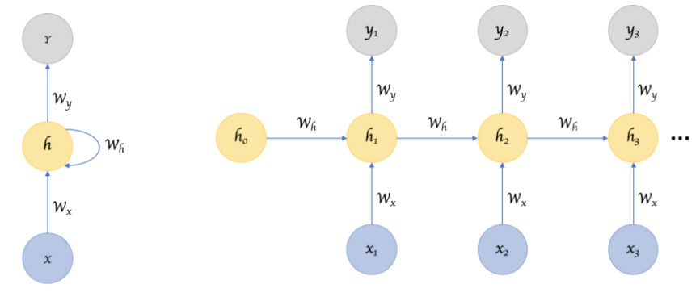
Introduction to RNN
≡

Slide 88
Forward Propagation in RNN
Example: Consider the word ‘dogs’. Show forward propagation of RNN with three nodes in hidden layer to predict letter ‘s’ given the letters ‘d’, ‘o’, and ‘g’. Assume that hidden layer activation function is Tanh and activation in output layer is softmax.
Solution
One hot encoding of the input: input vocabulary{d, o, g, s}
d | o | g | s
1 | 0 | 0 | 0
0 | 1 | 0 | 0
0 | 0 | 1 | 0
0 | 0 | 0 | 1

Slide 89
Forward Propagation in RNN
We know that:
Here, dimension of w_{h} is d × d, dimension of w_{x} is d × k, and dimension of w_{y} is k × d. Where, d is number of hidden nodes, and k is dimension of input vector.
Assume that:

Slide 90
Forward Propagation in RNN
Thus, (for input ‘d’)
At t=1, RNN predicts the letter “d” given the input “d”. This doesn’t make sense but it’s ok because we’ve used untrained random weights.

Slide 91
Forward Propagation in RNN
Example: Consider the input series {0.2,0.4,0.6, 0.8}. Show forward propagation of RNN with one node in hidden layer to predict next term in the series. Assume that activation function of hidden layer is sigmoid and activation in output layer is linear.
Solution {Input: 0.2 }

Slide 92
Forward Propagation in RNN
Example: Consider the input series {0.2,0.4,0.6, 0.8}. Show forward propagation of RNN with two nodes in hidden layer to predict next term in the series using previous two terms. Assume that activation function of hidden layer is sigmoid and activation in output layer is linear.
Solution {Input: [0.2,0.4] }

Slide 93
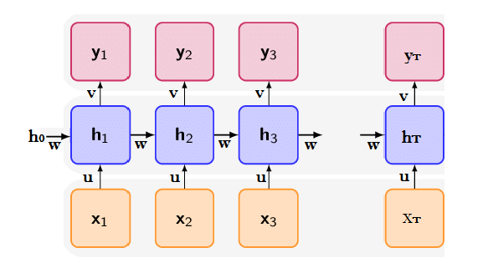
Backpropagation Through Time (BPTT)
BPTT is gradient based algorithm for training recurrent neural networks.
Unrolling of RNN with T layers looks like below, where w, u, v are weigh matrices.

Slide 94
Backpropagation Through Time (BPTT)
Let L is total loss in the RNN. Then the weights w, u, v are updated as below.
Thus, we need to compute for updating weights.

Slide 95
Backpropagation Through Time (BPTT)
Let L_{t} is the loss at t^{th} step of RNN. Then total loss of the RNN is given by.
Loss function can be different according to need. Basically, cross-entropy or least square loss function is used. Normally, Cross-entropy loss function is used for classification problems whereas least square loss function is used for regression problems.

Slide 96
Backpropagation Through Time (BPTT)
Recall that computation of hidden state and output in RNN is performed as below:
Recall that, we need to compute for BPTT. Assume that t=3
Also, assume that

Slide 97
Backpropagation Through Time (BPTT)
Now,
Here,
In the above relation derivative of h₂ needs to be computed recursively in terms of h₁.

Slide 98
Backpropagation Through Time (BPTT)
Finally,
Again, in the above relation, derivative of h₂ needs to be computed recursively in terms of h₁.
Since the derivatives needs to be calculated recursively by back propagating through time the algorithm is named as BPTT.

Slide 99
Backpropagation Through Time (BPTT)
Algorithm
For i=1 to T Compute y_{i} and L_{i} as below
For i=1 to T Compute following gradients
Find total gradient by summing all local gradients
Update weights as below

Slide 100
Vanishing Gradient and Truncated BPTT
Two main problems associated with Recurrent Neural networks are:
Gradient calculations either vanish or explode
Gradient calculations are expensive
Solution to exploding gradient is gradient clipping and solution to vanishing gradient problem is to use alternate architectures like gated recurrent unit (GRU) network and Long Short-term Memory (LSTM) network. Both, GRU and LSTM are variants of RNN architecture.
Solution to second problem is to used truncated BPTT algorithm

Slide 101
Vanishing Gradient and Truncated BPTT
RNNs might have a difficulty in learning long range dependencies. For instance if we have a sentence like “The man who ate my pizza has purple hair”. In this case, the description purple hair is for the man and not for the pizza. So this is a long dependency.
In BPTT algorithm, we need to compute gradient of loss to update weights.
In order to compute loss we need to use recursive computation.
For instance following two gradients can be computed as below.

Slide 102
Vanishing Gradient and Truncated BPTT
In the above equations gradient of h_{t-1} needs to be computed recursively in terms of h_{t-2} . Thus, the weight matrix w is multiplied by many times while computing the gradients.

Slide 103
Vanishing Gradient and Truncated BPTT
If w is small, we experience a vanishing gradient problem. And if w is large, we experience an exploding gradient problem.
The lower the gradient is, the harder it is for the network to update the weights and the longer it takes to get to the final result.
Exploding gradients are a problem where large error gradients accumulate and result in very large updates to neural network model weights during training. This has the effect of our model being unstable and unable to learn from your training data.

Slide 104
Vanishing Gradient and Truncated BPTT
In BPTT algorithm we need to back propagate through entire sequence in order to compute gradient of local loss. Thus, computation of gradient of loss is time consuming process.
The practical solution is limit the backpropagation to a maximum of window of M steps. The forward pass should still be performed over the entire sequence, but the backward pass is truncated to windows of size M.
This modified version of BPTT algorithm is called Truncated BPTT or TBPTT.

Slide 105
Long Short-term Memory
Because of the vanishing gradient problem, RNNs cannot remember long-term dependencies in time series data.
LSTM is an RNN variant designed to address this issue. LSTM, like RNN, has a hidden state that serves as short-term memory.
Furthermore, it maintains cell state, which serves as long-term memory.

Slide 106
Long Short-term Memory
The LSTM architecture is made up of three gates: a forget gate, an input gate, and an output gate.
The forget gate is in charge of determining what information must be remembered and what can be forgotten from the previous state.
The input gate determines which information from the current input is stored in the cell state.

Slide 107
Long Short-term Memory
Finally, the output gate determines the next hidden state value.
The LSTM network's architecture is depicted in the Figure and mathematical formulation is given in Equation given in next slide..

Slide 108
Long Short-term Memory
×
+
C_{t}
C_{t-1}
×
σ
σ
tanh
tanh
σ
×
H_{t}
H_{t-1}
x_{t}

Slide 109
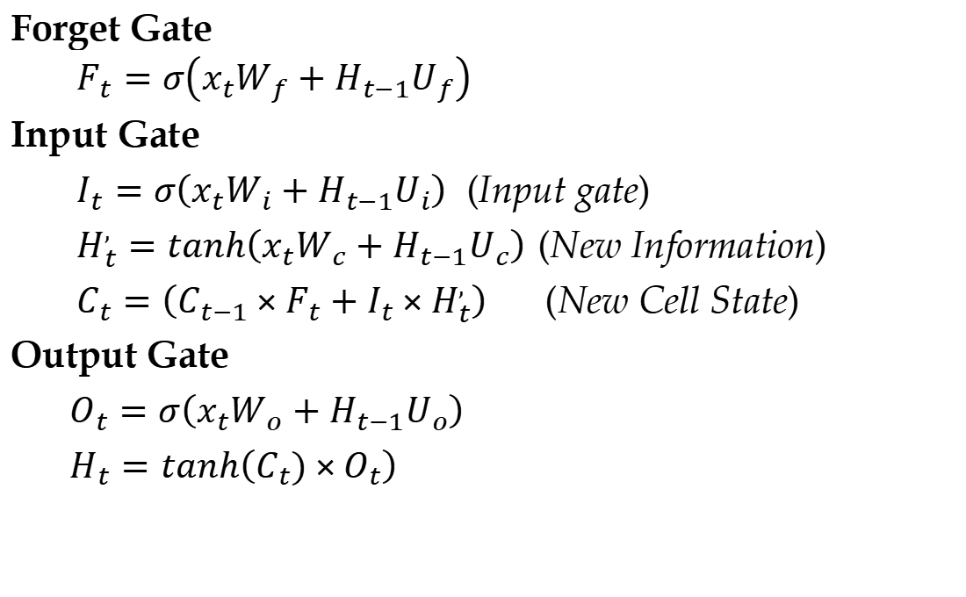
Long Short-term Memory
Forget Gate
$$F_{t}=σ\left(x_{t}W_{f}+H_{t−1}U_{f}\right)$$
Input Gate
$I_{t}=σ\left(x_{t}W_{i}+H_{t−1}U_{i}\right)$ (Input gate)
$H_{t}^{,}=tanh\left(x_{t}W_{c}+H_{t−1}U_{c}\right)$ (New Information)
$C_{t}=\left(C_{t−1}×F_{t}+I_{t}×H_{t}^{,}\right)$ (New Cell State)
Output Gate
$O_{t}=σ\left(x_{t}W_{o}+H_{t−1}U_{o}\right)$
$H_{t}=tanh\left(C_{t})×O_{t}\right)$

Slide 110
Long Short-term Memory
Here, W_{f} , W_{i}, W_{o}, U_{f}, U_{i}, and U_{o} are weight matrices. x_{t} is input at time step t, H_{t} is hidden state at time t, C_{t} is cell state at time t, O_{t} is output at time t, and H’_{t} is candidate hidden state at time t. × is point-wise multiplication and + is point-wise addition.

Slide 111
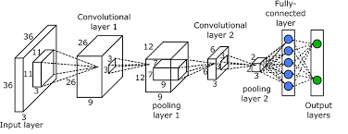
Convolutional Neural Network(CNN)
CNN is a type of multilayer neural network specially designed for detecting, recognizing, and classifying images.
Every CNN consist following three types of layers: Convolution Layer, Pooling layer, and Fully-connected Layer. Typical architecture of CNN is shown below:

Slide 112
Convolutional Neural Network(CNN)
Convolution Layer
Convolution layer extracts features from an input image. It preserves the relationship between pixels by learning image features using small squares of input data. It is a mathematical operation that takes two inputs such as image matrix and a filter or kernel and produces an image with convolved features.
Consider a 5 x 5 image whose pixel values are 0, 1 and filter matrix 3 x 3 as shown in below.
The matrix formed by sliding the filter over the image and computing the dot product is called Feature Map or Convolved Feature.

Slide 113
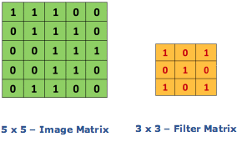
Convolutional Neural Network(CNN)
Convolution Layer
Convolution of an image with different filters can perform operations such as edge detection, blur and sharpen by applying filters.
4 | 3 | 4
2 | 4 | 3
2 | 3 | 4
Feature Map

Slide 114
Convolutional Neural Network(CNN)
Pooling Layer
Spatial Pooling or simply Pooling reduces the dimensionality of each feature map but retains the most important information.
It is also called sub-sampling or down-sampling. Spatial Pooling can be of different types: Max, Average, Sum etc.
In case of Max Pooling, we define a spatial neighborhood (for example, a 3×3 window) and take the largest element from the rectified feature map within that window.

Slide 115
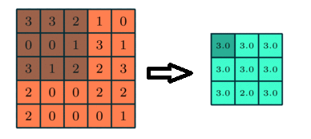
Convolutional Neural Network(CNN)
Pooling Layer
Instead of taking the largest element we could also take the average (Average Pooling) or sum of all elements in that window. In practice, Max Pooling has been shown to work better.
Figure: 3x3 Max Pooling over 5x5 convolved feature

Slide 116
Convolutional Neural Network(CNN)
Fully Connected Layer
The Fully Connected layer is a traditional Multi Layer Perceptron that uses a softmax activation function in the output layer. The term “Fully Connected” implies that every neuron in the previous layer is connected to every neuron on the next layer.
The output from the Convolutional and Pooling layers represent high-level features of the input image. The purpose of the Fully Connected layer is to use these features for classifying the input image into various classes based on the training dataset.

Slide 117
Convolutional Neural Network(CNN)
Fully Connected Layer
The Softmax function takes a vector of arbitrary real-valued scores and squashes it to a vector of values between zero and one that sum to one.
The Fully-Connected layer learns non-linear function in output produced by Convolutional and Pooling Layer.
We should flatten the image into a column vector. The flattened output is fed to the Fully Connected Layer and backpropagation can be applied to train the network.

Slide 118
Convolutional Neural Network(CNN)
Example
Consider following 6x6 image and 3x3 filter as below. Compute feature map and pooled feature map using 2x2 window. Use Max pooling.
255 | 200 | 120 | 89 | 0 | 180
210 | 230 | 170 | 165 | 87 | 76
49 | 120 | 115 | 125 | 165 | 140
20 | 35 | 32 | 42 | 37 | 78
55 | 65 | 75 | 45 | 35 | 69
190 | 180 | 160 | 150 | 155 | 165
1 | 1 | 0
0 | 1 | 0
0 | 1 | 1

Slide 119
Convolutional Neural Network(CNN)
Example
Consider a 4 bit grey level image with resolution 6x6 and a 3x 3 filter whose all diagonal elements are 1 and non-diagonal elements are zero. Compute feature map and the compute pooled feature map using 3x3 window. Use average pooling.

